Slide 1
Announcement slide (dark) with color wipe
Cost-Effective, Low Latency Vector Search with Azure Cosmos DB
Nitish Upreti and Harsha Simhadri
Hari Sudan Sundar, Krishnan Sundaram, Samer Boshra, Balachandar Perumalswamy, Shivam Atri, Martin Chisholm, Revti Raman Singh, Greg Yang, Tamara Hass, Nitesh Dudhey, Subramanyam Pattipaka, Mark Hildebrand, Magdalen Manohar, Jack Moffitt, Haiyang Xu, Naren Datha, Suryansh Gupta, Ravishankar Krishnaswamy, Prashant Gupta, Abhishek Sahu, Hemeswari Varada, Sudhanshu Barthwal, Ritika Mor, James Codella, Shaun Cooper, Kevin Pilch, Simon Moreno, Aayush Kataria, Santosh Kulkarni, Neil Deshpande, Amar Sagare, Dinesh Billa, Zishan Fu, Vipul Vishal
Notes:
Hello everyone, I am Nitish with my collague Harsha. Today we will be presenting our work :
This is a joint work between Microsoft Product and Microsoft Research group.

Slide 2

Announcement slide (dark) with color wipe
Azure Cosmos DB for NoSQL Serverless, Scalable, Operational Database
Cosmos DB Scenarios
Cosmos DB Highlights
Cosmos DB is Cost Effective
Chat History
Agentic Memories
Document Storage
E-Commerce
User interactions
Low Latency (P99 <10ms) and High Availability (99.999%)
Global Distribution
Tunable consistency levels
Flexible Schema with JSON model
Enterprise Ready : VNET, CMK, RBAC
Serverless, Instant Auto-scale and Provisioned model
Operational Database
Vector DB
Operational Database
With integrated
Vector Index
OR
Notes:
Azure Cosmos DB is Serverless, Scalable, Operational Database.
Some of the applications for CosmosDB include conversational history, agentic memory and document storage among others.
It offers low latency , high availability and global distribution while being extremely cost effective.
-- >
As semantic search on these scenarios becomes very important, users expect vector search, and one potential architecture is to replicate the data in a separate vector DB.
However, this adds complexity and cost.
OR - ->
A better architecture might be to integrate vector indexing within an operational database like Cosmos DB.

Slide 3




Key Results with Cosmos DB and DiskANN
Performance
<20ms query latency on 10M vectors.
< 2X increase in latency/cost as index scales from 100D->768D, 100K->10M vectors.
Stable Recall and Latency
Stable Recall over long stream of updates even with distribution drift.
No ingestion or query latency spikes due to rebuilds or segment merges.
Filtering and Multi-tenancy
Filtered queries with upto 8X better P99 cost and latency with new algorithms.
Native Multi-Tenancy: Fast Search and High Recall on a long tail of tenants.
Cost and Scale
Scale out to 1 Billion Vectors with automatic partitioning.
Lower query costs. Upto 43X and 12X than Pinecone and Zilliz respectively at 10M scale
Notes:
With this work, we show that not only is this possible with CosmosDB, but we can do this in a highly performant fashion.
(Read from slide)

Slide 4
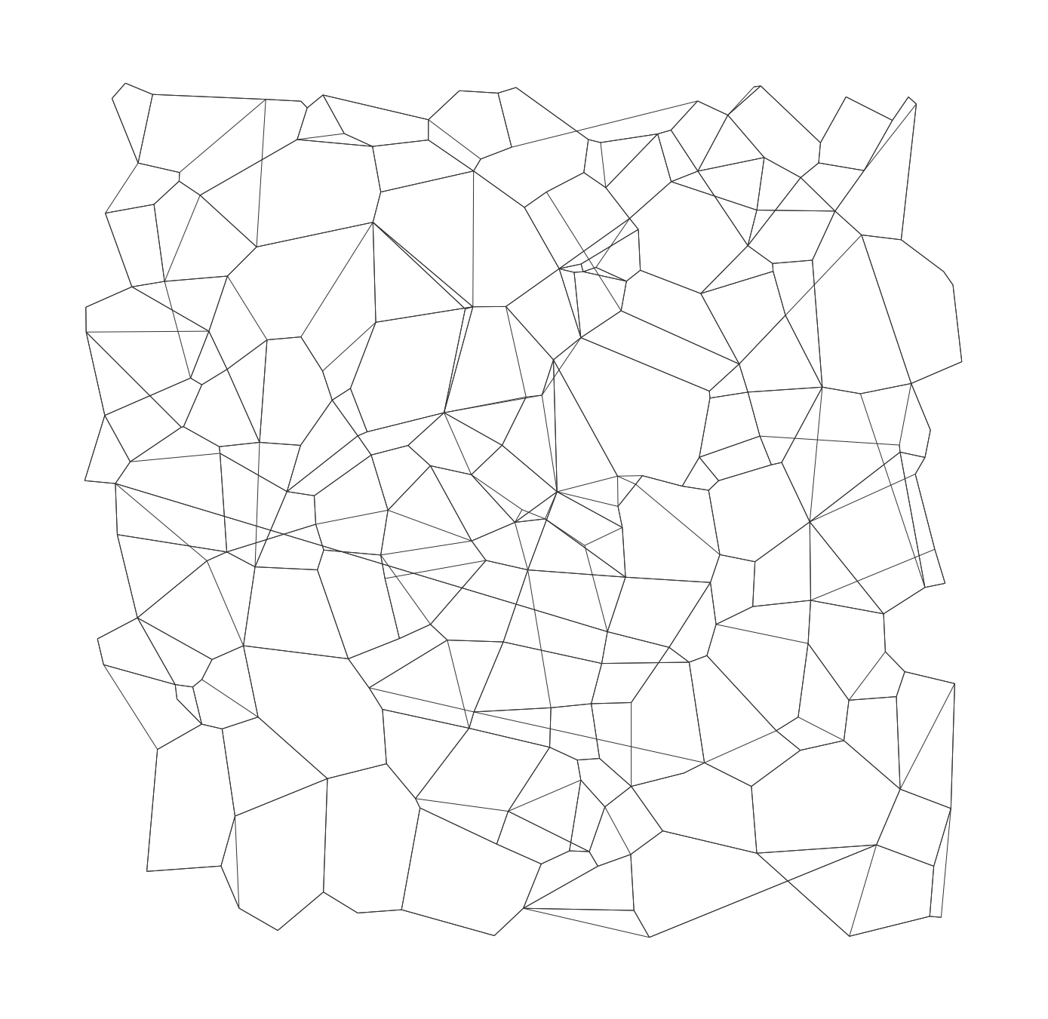
DiskANN: A Graph-based Vector Indexing Library
Index:
Directed graph with one vertex per data point/vector.
For query q:
Start at designated start s, and iterate:
compute dist. from q to neighbors
hop to node closest to q,
as long as distance improves
o9
s
q

Slide 5

CosmosDB Constraints and DiskANN Innovations
1.
Continuous updates interleaved with queries, served without latency spikes that index rebuilds or segment merges cause.
One Vector Index
+
In-place update of graph edges in index for each Insert / Delete in LSN order.
Segment Index
2.
Multi-tenant system has limited DRAM and CPU, Vectors too expensive to store In-memory for perf.
DRAM
DRAM
Re-design DiskANN to process updates with only quantized representations of vectors cached by Cosmos DB.
SSD
SSD
3.
Post-Filtering for arbitrary predicates + tenant filtering yields low recall.
Use fast predicate evaluation to guide graph navigation of the query, yields more results.
Notes:
Harsha to write down

Slide 6
DiskANN + Store : Re-Architecting for any Database
In-Mem
Quantized VectorProvider
K-V stores
Vector Provider
Update
DiskANN indexing and search algorithms
(stateless)
Update
Encode
Cosmos DB
Edge List
Provider
Query
Read
Read
B*-tree
Label/Metadata Provider
File System
Separate index logic from storage semantics.
Inherit elasticity, availability, and durability of host DB
Operate at multiple storage tiers
One branch for Research and Production
Notes:
We re-architected diskann to be stateless by yielding the management of index terms to the database. It acceses and updates these through a standardized Provider Interface.
The separation of indexing logic from storage semantics makes it easy to integrate diskann into any database or k-v store, and operate at multiple storage tiers.
This also allows diskann index to inherit the elasticity, availability and durability of host DB such as cosmos DB.

Slide 7
DiskANN + Cosmos DB: Mapping Terms to Store
Cosmos DB Replica
Quantized VectorProvider
Encode / Read
DiskANN indexing and search algorithms
(stateless)
Adjacency List Provider
Bw-Tree
Cosmos DB Indexer
Update
Set
Encode/Read
Vector Provider
Query Engine
Query
Get
Read
Doc Store
Predicate Evaluator
Notes:
Zooming into a Cosmos DB Replica. It consists of two different stores – the Doc store which contains the entire JSON doc along with full vectors and the Bw-tree which holds the quant vector and graph indexing terms which are more compact and high cachable.

Slide 8
DiskANN + Cosmos DB: Documents, Multitenant Index…
Cosmos DB Replica
Quantized VectorProvider
DiskANN indexing and search algorithms
(stateless)
Adjacency List Provider
Bw-Tree
Cosmos DB Indexer
Update
Get
Encode
Vector Provider
Query Engine
Query
Set
Read
Doc Store
Predicate Evaluator
(Index per shard with
co-located Index terms)
{ // Sample chat history json
/userID: 12345,
/chat_txt: “hello world!”,
/chat_vector: [0.1,0.5,…],
...
}
SELECT TOP 10 CustomerChat FROM c ORDER BY VectorDistance(c.chat_vector, {queryChatVector})
WHERE c.userId = “user“
Sample Query
Notes:
Now let us see a multi-tenant example with user chat history.
We have a sample chat history json with userid, chat text and chat vector.
-->
A vector search query in this scenario will always have a userid filter (given the query is always in context of a particular user). In order to server this query with low latency and high recall, we need to shard our index per user or tenant even within a single replica instance.
-->
With CosmosDB and DiskANN we can do just that by building a diskann index pe tenant/shard with co-located index shard terms for efficient locality and caching.

Slide 9
DiskANN + Cosmos DB: Control Flow Illustration
Cosmos DB Replica
Quantized VectorProvider
insert
get_nghbrs
Vector Provider
Bw-Tree
Cosmos DB Indexer
Update
DiskANN indexing and search algorithms
(stateless)
Update
Encode
get_quantvec
neighbors
Quant_vec
update_nghbrs
Edge List
Provider
Query Engine
Query
Read
Read
Doc Store
Label/Metadata Provider
Notes:
We have seen how Cosmos dB and diskann are integrated, and how cosmos db replica stores diskann index terms.
Now lets consider how a vector is inserted in this system.
The cosmos db indexer process presents the vector to DiskANN, which is responsible for mutating the index terms in Cosmos dB’ bw tree to reflect this new vector.
In order to do this, diskann navigates the graph using neighbor provider to fetch ids of neighbors, and then the quantized representation of the neighbors, perform some distance computations.
After a few iterations, it decides the new edges to connect and mutates the index through set/append requests to the neighbor provider.
To process 1 vector, DiskANN needs to process a few 1000 quant vectors and ~100 adjacency lists which translate to as many random reads to bw tree

Slide 10
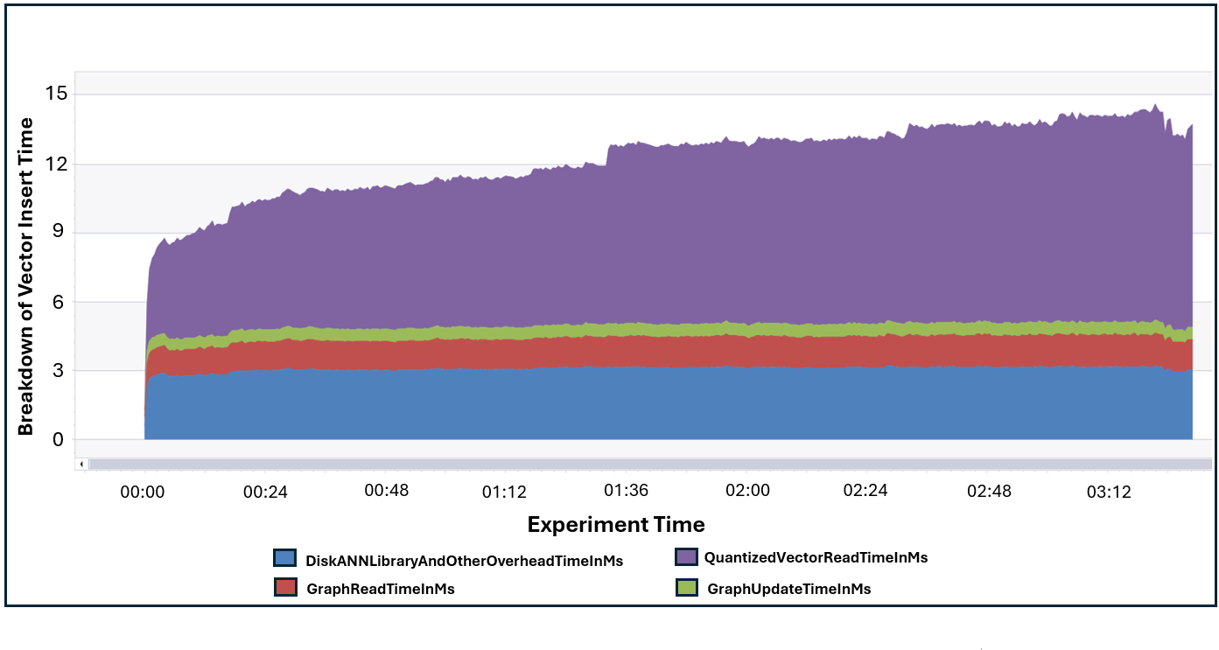
Ingestion time is dominated by quantized vector reads
MS-Turing 1-Million vector Ingestion
Notes:
Harsha
This reflects in the breakdown of where ingestion spends its time.
Most of the CPU time is spent accessing the quantized vectors (upto 7ms), as expected. Since they are cached, this operation is synchronous.
The next components is the time spent in DiskANN library (actual distance computations as well as calculating updating candidate sets < 3ms)
Finally reading the adjacency lists. (<2ms)
Graph update time is very tiny

Slide 11
Query latency and cost scales sub-linearly with Index Size and Vector Dimension
P50 Query Latency (ms)
Notes:
What is the claim and why/how we achieved it. Nitish
Query latency scales sub-linearly with the size of the dataset. This is because DiskANN graph search complexity scales logarithmically.
Query latency scales sub-linearly with vector dimension as well given query mostly rely on Quantized vector which provide significant size reduction and are cached.

Slide 12
Scale-Out to 1 Billion Vectors (50 Physical Partitions x 20M vectors)
Query Latency (ms)
MS-Turing 1B dataset
Notes:
This is a scenario where CosmosDB scales out to 1Billion Ms-Turing vectors with 50 physical partitions each with 20million vectors. In this case, the client fans out and get a Top K result per physical partition and then computes a global Top-K.
We see that even with one billion vectors, P99 client latency is under 100ms.

Slide 13
Sharded search 3X faster@p99, +32% Recall
Query Latency (ms)
Notes:
So here, we demonstrate the power of Sharded DiskANN by indexing 1 million vectors from the YFCC image dataset. Each document corresponds to a 192-dimensional image CLIP embedding with diskann index sharded by image year
Looking at P99 latency in the green plot, we can see that for non-sharded scenario …
(2004 – 2014). The number of documents per year ranges from ~30,000 to ~144,000.
SELECT TOP 10 *
FROM c
ORDER BY VectorDistance(c.embedding, {queryVector})
WHERE c.year = "YEAR"
3x improvement in latency with 1.5X better recall at comparable settings. 10X better latency when matching recall

Slide 14
Multi-tenant search 3X faster@p99, +32% Recall
Query Latency (ms)
Notes:
In order for Non-Sharded index to come close (and still not match) the recall offered by a sharded setup, we need to pay a very high query latency penalty of around 164ms.
overall

Slide 15
8x faster Predicate Search with Filter aware search at P99
Query Latency (ms)

Slide 16
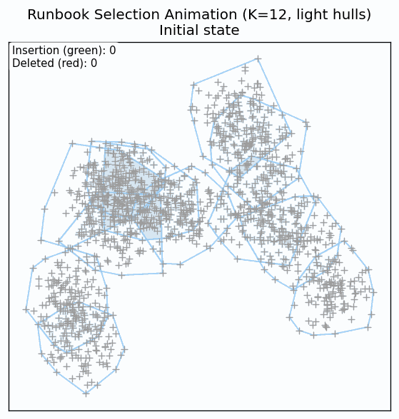
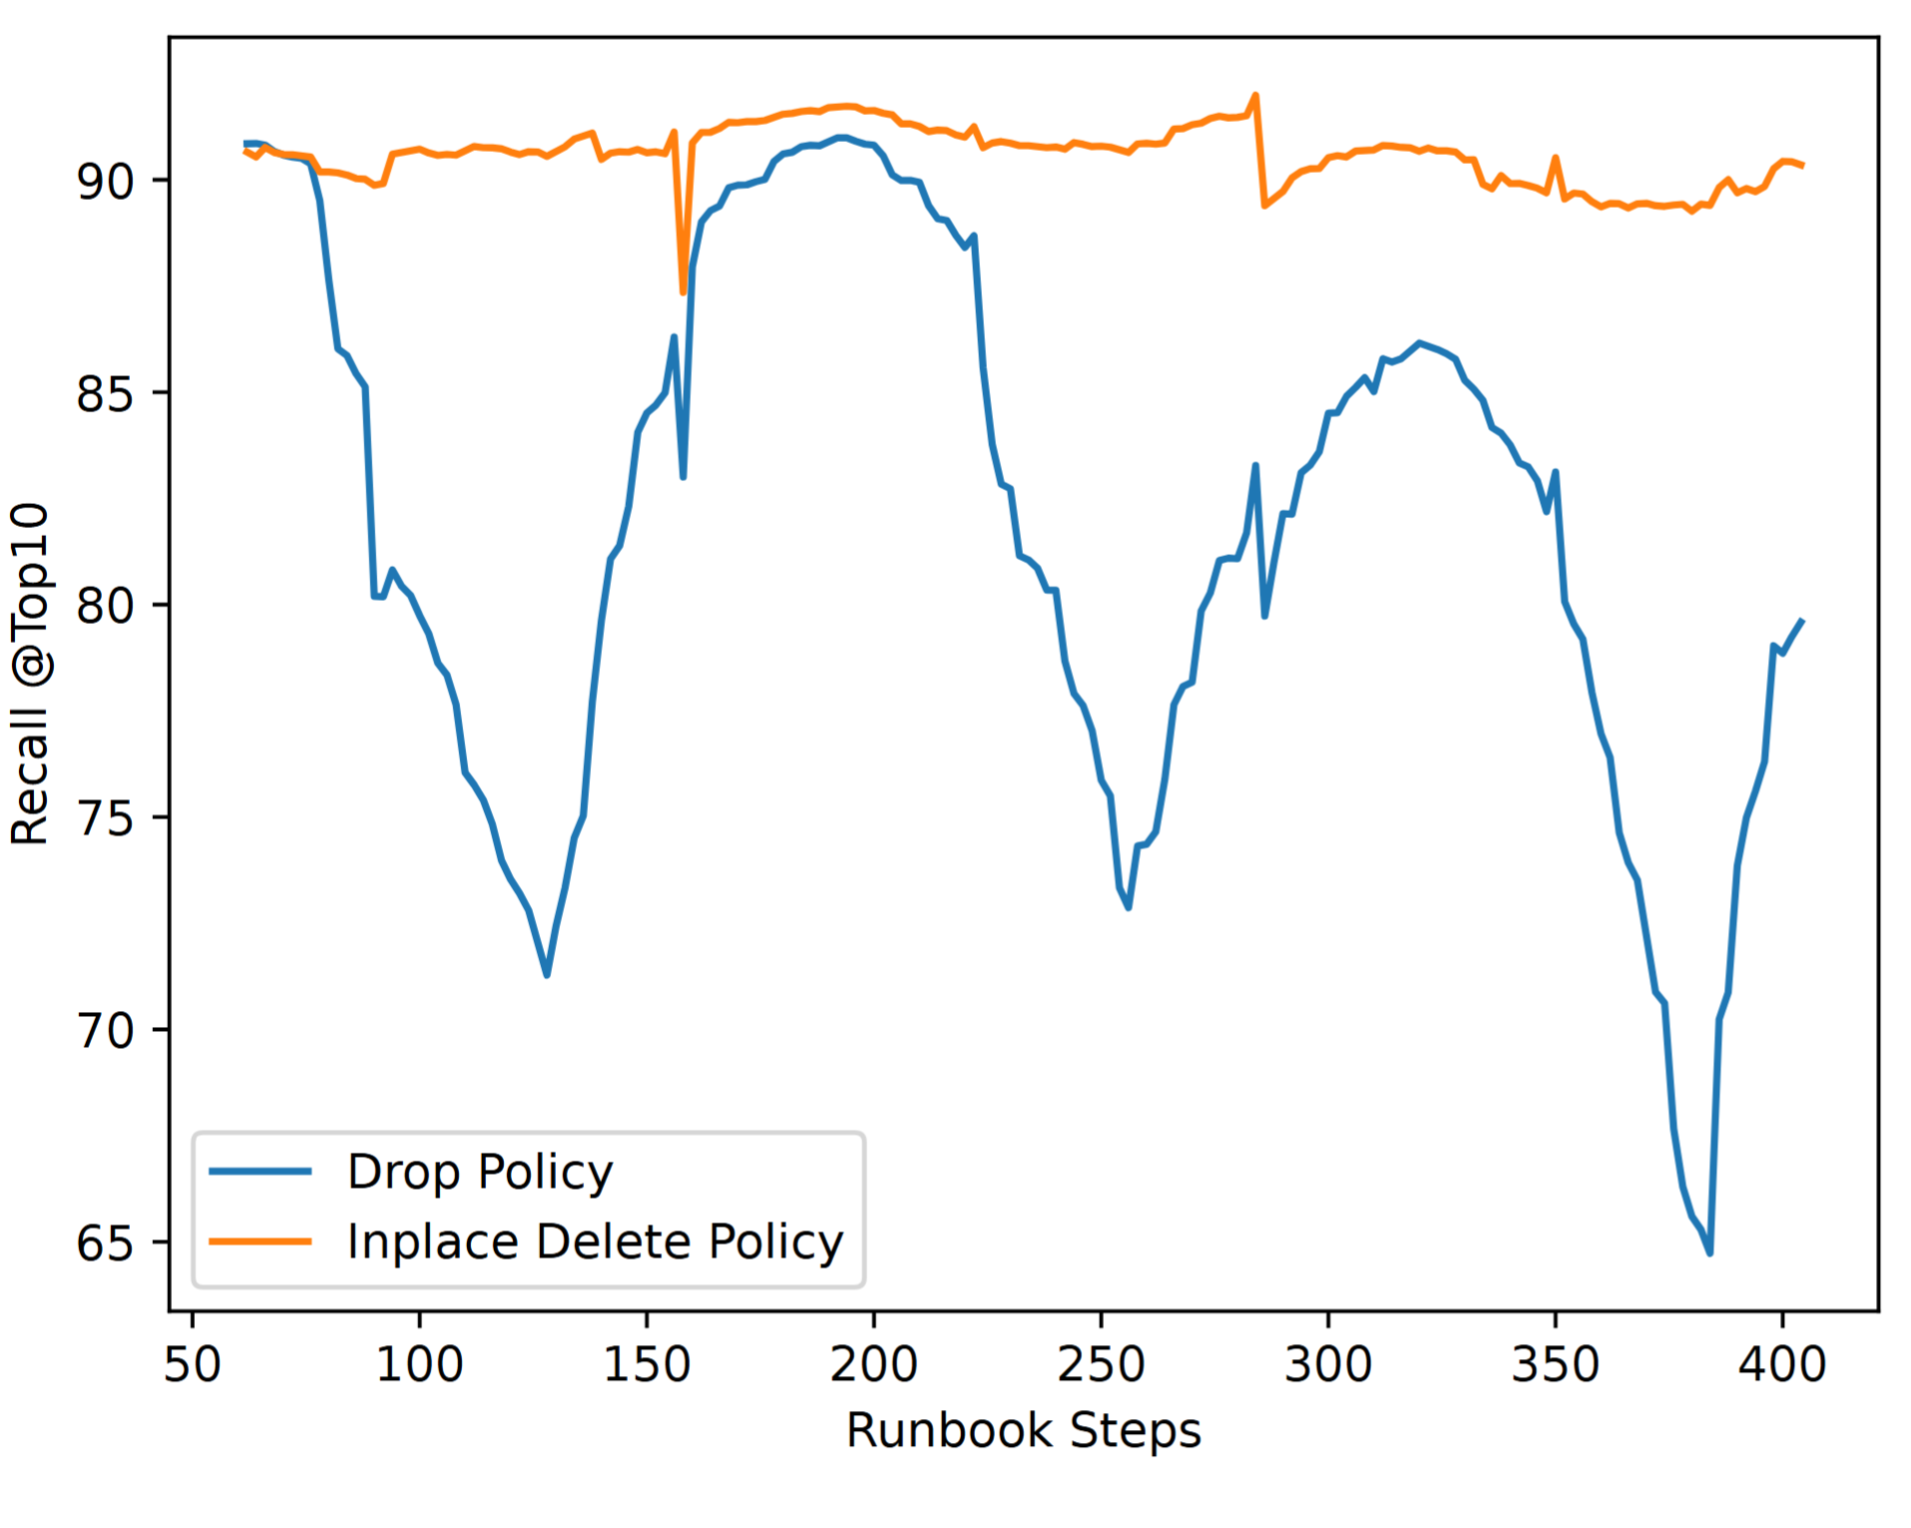
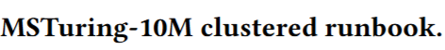
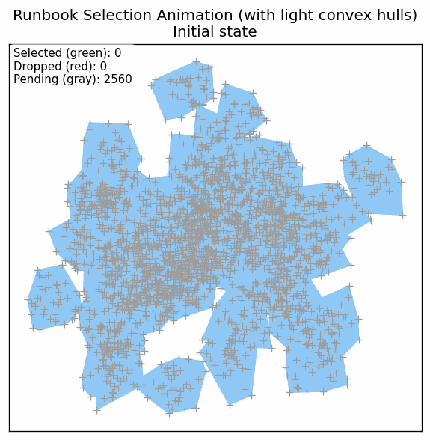
Stable recall over long change of updates
Recall comparison between DiskANN in-place deletes VS simple drop policy.
MSTuring-10M clustered runbook.
Notes:
Perfect—added light convex hulls per cluster and reduced the number of rounds to one‑third of the original (5 → 2 rounds). Here’s the updated animation:
What changed
Light convex hulls (per cluster):\ Each cluster’s 2D projection is wrapped with a soft, translucent hull (thin light-blue outline with a very faint fill) drawn behind the points. This helps the audience see cluster extents without overpowering the selected/dropped status colors.
Fewer rounds (one‑third):\ From 5 rounds down to 2 rounds. The per-cluster step still picks 1/3 of the remaining points (green “+”) and drops 1/5 (red “+”) each time; the rest stay pending (gray “+”). Animation still updates after each cluster within each round, so it remains granular but shorter overall.
Updated, self‑contained Python script
Output: runbook_selection_animation_hulls.gif\ Deps: numpy, matplotlib, Pillow, scipy (for convex hulls)
import numpy as np
import os
from PIL import Image
import matplotlib
matplotlib.use('Agg') # headless-safe
import matplotlib.pyplot as plt
from matplotlib.patches import Polygon
from matplotlib.collections import PatchCollection
from scipy.spatial import ConvexHull
# ---------------- Parameters ----------------
SEED = 42
K = 64 # clusters
D = 1000 # dimensionality
POINTSPERCLUSTER = 40 # tweak for density / file size
ROUNDSORIGINAL = 5
ROUNDS = max(1, int(round(ROUNDSORIGINAL/3))) # one-third as many rounds (~2)
PICKFRAC = 1/3 # per-cluster, per-round pick fraction
DROPFRAC = 1/5 # per-cluster, per-round drop fraction
FIGSIZE = (6.6, 5.6) # inches
DPI = 120
MARKERSIZE = 6
FRAMEDIR = 'framesrunbookgifhulls' # temp frames
GIFPATH = 'runbookselectionanimationhulls.gif' # final output
# --------------------------------------------
np.random.seed(SEED)
# 1) Generate clustered data in 1000D
N = K POINTSPERCLUSTER
centers = np.random.normal(0, 5, (K, D))
X = np.empty((N, D), dtype=np.float32)
labels = np.empty(N, dtype=np.int32)
sigma = 1.0
idx = 0
for k in range(K):
pts = np.random.normal(0, sigma, (POINTSPERCLUSTER, D)).astype(np.float32)
pts += centers[k]
X[idx:idx+POINTSPERCLUSTER] = pts
labels[idx:idx+POINTSPERCLUSTER] = k
idx += POINTSPERCLUSTER
# 2) 1000D -> 2D via random Gaussian projection
R = np.random.normal(size=(D, 2)).astype(np.float32)
R /= np.linalg.norm(R, axis=0, keepdims=True)
XY = X @ R
# Plot bounds
xymin = XY.min(axis=0)
xymax = XY.max(axis=0)
margin = 0.05 (xymax - xymin)
plotmin = xymin - margin
plotmax = xymax + margin
# 3) Selection state: 0=pending, 1=selected, -1=dropped
state = np.zeros(N, dtype=np.int8)
# Clean frames dir
os.makedirs(FRAMEDIR, existok=True)
for f in os.listdir(FRAMEDIR):
if f.endswith('.png'):
try: os.remove(os.path.join(FRAMEDIR, f))
except Exception: pass
# 3.5) Precompute light convex hulls per cluster (static)
hullpatches = []
for k in range(K):
pts2d = XY[labels == k]
if pts2d.shape[0] >= 3:
try:
ch = ConvexHull(pts2d)
verts = pts2d[ch.vertices]
hullpatches.append(Polygon(verts, closed=True))
except Exception:
pass
# Hull styling (light blue)
HULLEDGEALPHA = 0.6
HULLFACEALPHA = 0.06
EDGERGBA = (0.565, 0.792, 0.976, HULLEDGEALPHA) # #90caf9
FACERGBA = (0.565, 0.792, 0.976, HULLFACEALPHA)
framepaths = []
def renderframe(roundidx, clusteridx, frameno):
fig, ax = plt.subplots(figsize=FIGSIZE, dpi=DPI)
# Hulls behind points
if hullpatches:
pc = PatchCollection(hullpatches, linewidths=0.8)
pc.setfacecolor(FACERGBA)
pc.setedgecolor(EDGERGBA)
ax.addcollection(pc)
# Points layered by state
maskp = (state == 0)
masks = (state == 1)
maskd = (state == -1)
if np.any(maskp):
ax.plot(XY[maskp, 0], XY[maskp, 1], '+', color='#9e9e9e',
markersize=MARKERSIZE, markeredgewidth=0.8, linestyle='None')
if np.any(masks):
ax.plot(XY[masks, 0], XY[masks, 1], '+', color='#2e7d32',
markersize=MARKERSIZE, markeredgewidth=0.8, linestyle='None')
if np.any(maskd):
ax.plot(XY[maskd, 0], XY[maskd, 1], '+', color='#c62828',
markersize=MARKERSIZE, markeredgewidth=0.8, linestyle='None')
sel = int(np.sum(state == 1))
drp = int(np.sum(state == -1))
pend = int(np.sum(state == 0))
title = ("Runbook Selection Animation (light hulls)\nInitial state"
if roundidx < 0 else
f"Run {roundidx+1}/{ROUNDS} • Cluster {clusteridx+1}/{K}")
ax.settitle(title, fontsize=12)
ax.text(0.01, 0.99,
f"Selected (green): {sel}\nDropped (red): {drp}\nPending (gray): {pend}",
transform=ax.transAxes, va='top', ha='left', fontsize=9,
bbox=dict(boxstyle='round', facecolor='white', alpha=0.75, lw=0))
ax.setxlim([plotmin[0], plotmax[0]])
ax.setylim([plotmin[1], plotmax[1]])
ax.setxticks([]); ax.setyticks([])
ax.setaspect('equal')
ax.setfacecolor('white')
fp = os.path.join(FRAMEDIR, f"frame{frameno:04d}.png")
fig.savefig(fp, bboxinches='tight')
plt.close(fig)
return fp
# Initial frame
framepaths.append(renderframe(-1, -1, 0))
framesdone = 1
# Rounds; animate after each cluster
for r in range(ROUNDS):
for k in range(K):
idxs = np.where(labels == k)[0]
remain = idxs[state[idxs] == 0]
if remain.size > 0:
npick = int(np.floor(remain.size PICKFRAC))
if npick > 0:
pick = np.random.choice(remain, size=npick, replace=False)
state[pick] = 1
remain = idxs[state[idxs] == 0]
if remain.size > 0:
ndrop = int(np.floor(remain.size DROPFRAC))
if ndrop > 0:
drop = np.random.choice(remain, size=ndrop, replace=False)
state[drop] = -1
framepaths.append(renderframe(r, k, framesdone))
framesdone += 1
# Assemble GIF
images = [Image.open(p) for p in framepaths]
images[0].save(
GIFPATH,
saveall=True,
appendimages=images[1:],
duration=200, # ms per frame
loop=0
)
print(f\"Saved to {GIFPATH}\")
Quick check
Rounds: Defaulted to 2 as “one‑third” of 5. If you meant “use 3 rounds” instead, I can regenerate instantly.
Hulls: Light and unobtrusive; drawn behind points. We can switch to per‑cluster alternating colors or add labels if needed.
Playback: Currently ~129 frames (1 + 64×2). Increase duration if you want a slower pace for presenting.
Would you like me to:
switch to 3 rounds instead,
color the hulls by cluster (alternating palette), or
export an MP4 version for smoother playback in PowerPoint?

Slide 17
Query costs 43x, 12x lower than Pinecone, Zilliz Serverless
Query Cost ($ per 1M Queries on 10M Wiki-Cohere Dataset)
Ingest Cost (10M Wiki-Cohere vectors)
Competitors prices from publicly available pricing and documentation as of July 14th, 2025.
Notes:
Add legen
Add Insert plot. Harsha
Ingestion is set so that indexer catches up within RU allocation
Query is charged by logical terms accessed in each tier

Slide 18
Announcement slide (dark) with color wipe
Conclusions
Vector Search in Operational Database can be Fast, Cost-effective, and Scalable.
Re-architecting vector indexing libraries as in-process stateless orchestrators enables efficient integration.
New algorithm ideas motivated by system constraints, and provide low latency, stable recall and reduce cost.
aks.ms/CosmosDB/VectorSearch

Slide 19
Place Holder
TBD

Slide 20
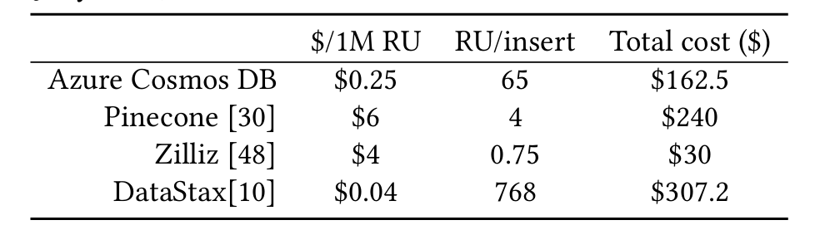
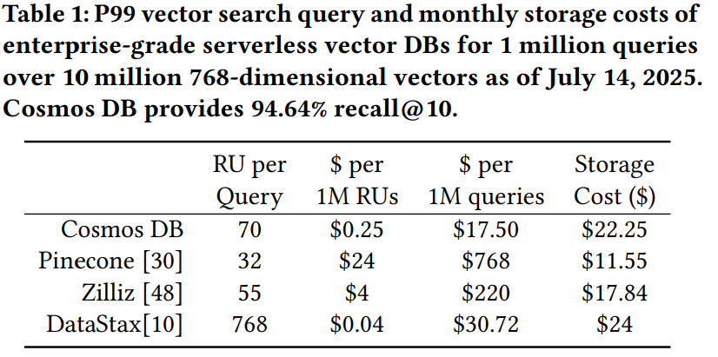
Query costs (43x, 12x) lower than Pinecone, Zilliz Serverless [ADD Ingest Cost]
Ingestion is set so that indexer catches up within RU allocation
Query is charged by logical terms accessed in each tier
Notes:
Add Insert plot. Harsha

Slide 21
Multi-tenant Search (YFCC Dataset)
Query Latency (in milli-seconds)
Scenario | Avg | P50 | P99 | Recall@10
Sharded Index (Ls = 100) | 7.2 | 10.07 | 13.43 | 98.09
Non-Sharded Index (Ls = 100) | 22.4 | 21.29 | 38.59 | 66.17
Non-Sharded Index (Ls = 1000) | 94 | 95.47 | 164 | 87
Notes:
Nitish. Replot
2x improvement in latency and RU for Amazon Products 1M dataset with 5 tenants
More improvements for higher partition counts
What was the predicate here?

Slide 22
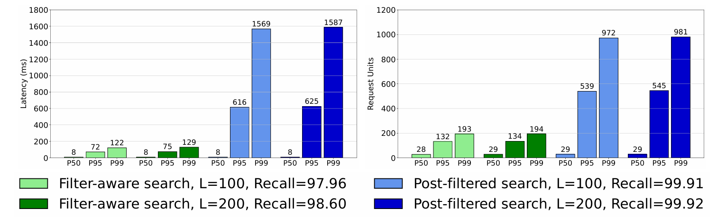
8x Faster Search at p99 with Predicates
Comparison of the query latency and cost of post filtering and filter-aware search on the YFCC dataset.
Notes:
Nitish. Replot. Show P50/P99. Pick latency and remove cost (follows same pattern)

Slide 23
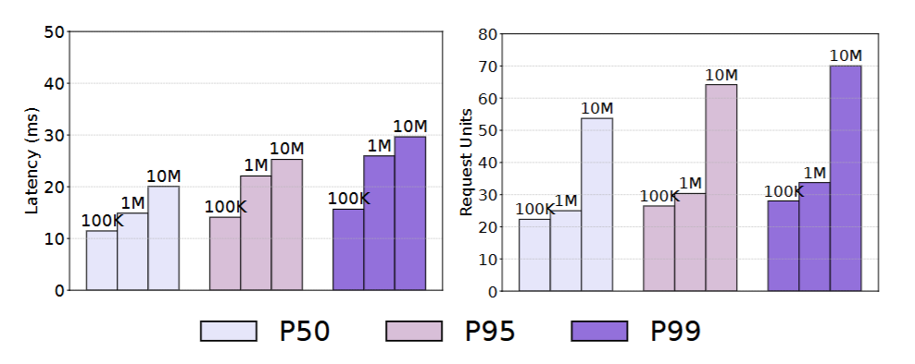
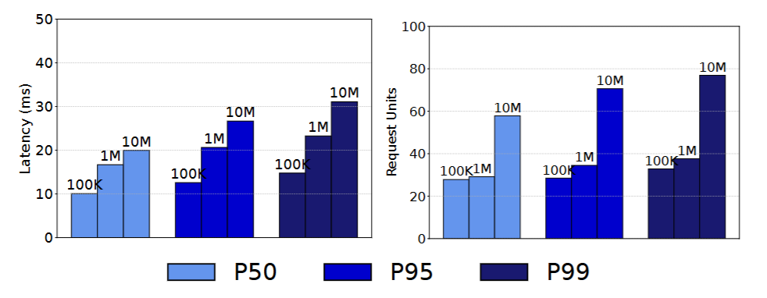
Latency scales sub-linearly (Index Size and Vector Dimension)
Wiki Cohere (768 Dimensions)
MS Turing (100 Dimensions)
Notes:
What is the claim and why/how we achieved it. Harsha
Query latency scales logarithmically with the size of the dataset

Slide 24
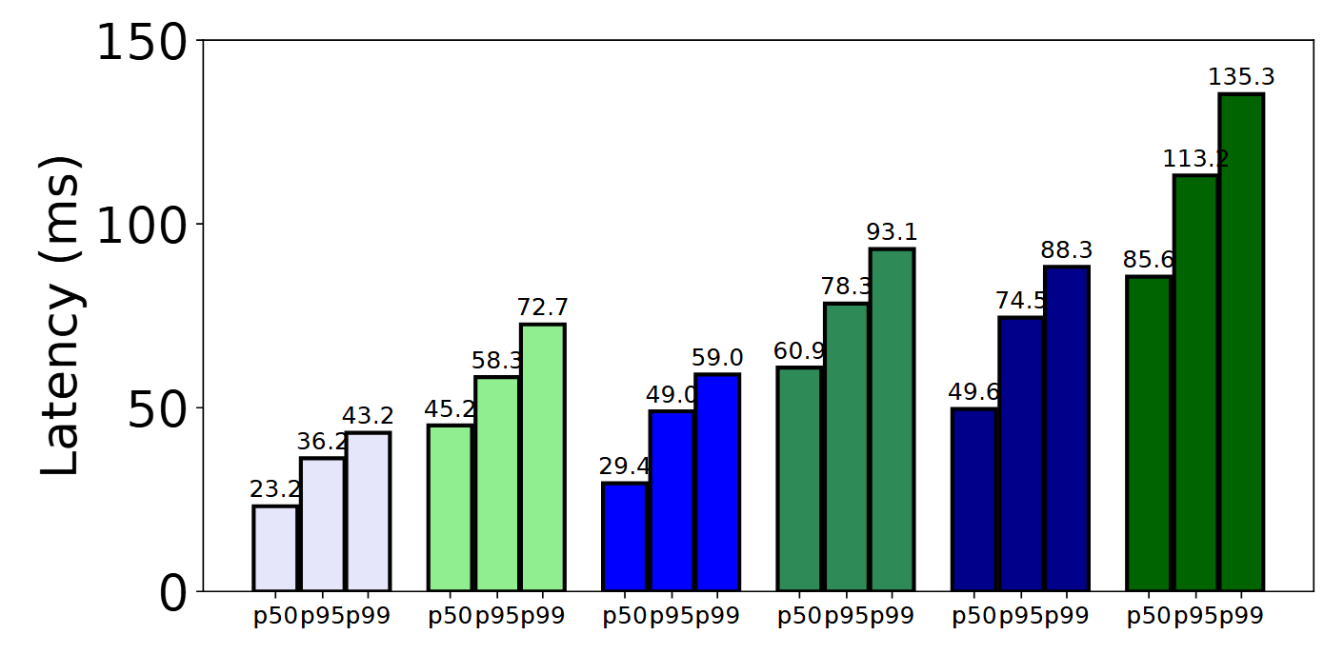
Scale-Out 1 Billion Vectors (MS-Turing Latency)
Notes:
Nitish (Plot and Message)

Slide 25
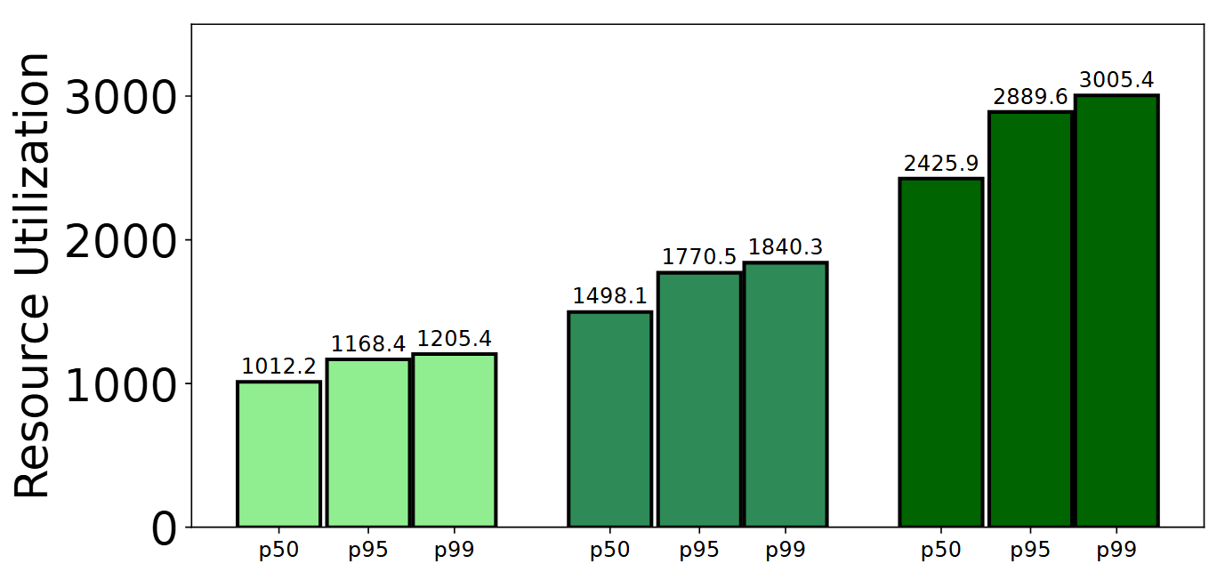
Scale-Out 1Billion Vectors (MS-Turing Cost scaling)
Notes:
Plot and Message

Slide 27



Full Text Search & Ranking
Full Text Search
Quickly and efficiently find keywords and terms in properties.
Search for text in documents.
Improved search relevancy and efficiency with Full Text Index.
Rank text search results by relevancy with BM25.
Text Analyzers
Tokenization
Stopword removal
Stemming
Text Ranking with BM25
Find the documents most relevant to your search
Notes:
Should we mention Hybrid Search if we are mentioning Full Text Search?

Slide 28
Cosmos DB and DiskANN Integration
Query Engine
Index Manager
DiskANN
/ TenantID : 12345
/ NonShardedVector : [0.1, 0.5, .. ]
[inverted terms… ]
/ ShardedVector : [1, 4, 7 … ]
[quantized terms…]
[graph terms…]
Full Precision Vectors
[Shard 1 (quant & graph terms)…]
[Shard 2 terms.. ]
Indexed Document
Document Store
Bw-Tree Index
Cosmos DB Replica
Notes:
High level CosmosDB integration
Quant vector, Graph term, Full Vectors. Different cache requirements based on access patterns (some numbers to show magnitude)
(Wiki Cohere) 1. Quant vec lookup = 20 (avg degree) * 100 Lbuild ~= 2000 2000 * 10 microseconds = 20msec 2. Adjacency List lookup = 100 Lbuild 100 * 25 microseconds ~= 2msec 3. Time spent in DiskANN = 3 msec (from past experiments on quantized only build) 4. Update cost (assuming negligible) So total cost = 20 + 3 + 2 ~= 25 msec which is 1000/25 = 40 inserts/thread/sec. With 16 threads, it should be 16 * 40 = 640 vectors/sec
Inline quantized vector generation combined with lazy Indexing allows fallback to Quantized Vector Scan?

Slide 29
Faster Search with Predicates [OLD NUMBERS, need to update; and ADD Figure to illustrate DataSet] (8x faster p99, 20x lower p99 RU)
Metric | Faster Search with Predicates | Paginated search + post-filtering
Recall (%) | 94.01 | 94.77
RU Consumption P50 | 40.54 | 29.97
RU Consumption P99 | 64.21 | 468.46
Server Latency (ms) P50 | 22.04 | 14.81
Server Latency (ms) P99 | 38.75 | 716.83
Amazon 1 million Product Catalog
SELECT {10} by similarity
Where: ARRAY_CONTAINS(c.category,"ExteriorAccessories") AND (c.rating = "4" OR c.rating = "5")

Slide 30
Cosmos DB and DiskANN Integration
Cosmos DB Storage
Document Store (for full vectors)
Bw-Tree Index (quantized and graph terms)
Typically, Quantized term in cache, full vectors on disk and adjacency lists may be cached.
A DiskANN Index is entirely represented of Key/Value entries in Bw-Tree
Large number of separate indexes (on multiple path / tenants) is feasible.
Fast Range scan on quantized vectors scoped to a given JSON Path and Tenant.
Effective Caching of Index hot set.
Co-located with non-vector terms in shared Bw-Tree instance.
Notes:
High level CosmosDB integration
Quant vector, Graph term, Full Vectors. Different cache requirements based on access patterns (some numbers to show magnitude)
(Wiki Cohere) 1. Quant vec lookup = 20 (avg degree) * 100 Lbuild ~= 2000 2000 * 10 microseconds = 20msec 2. Adjacency List lookup = 100 Lbuild 100 * 25 microseconds ~= 2msec 3. Time spent in DiskANN = 3 msec (from past experiments on quantized only build) 4. Update cost (assuming negligible) So total cost = 20 + 3 + 2 ~= 25 msec which is 1000/25 = 40 inserts/thread/sec. With 16 threads, it should be 16 * 40 = 640 vectors/sec
Inline quantized vector generation combined with lazy Indexing allows fallback to Quantized Vector Scan?

Slide 31
Query costs (43x, 12x) lower than Pinecone, Zilliz] Ingest cost lower than Pinecone and DataStax
Notes:
Add Insert plot. Harsha
Ingestion is set so that indexer catches up within RU allocation
Query is charged by logical terms accessed in each tier

Slide 32
DiskANN + Cosmos DB: Documents, Multitenant Index…
Cosmos DB Replica
Quantized VectorProvider
DiskANN indexing and search algorithms
(stateless)
Adjacency List Provider
Bw-Tree
Cosmos DB Indexer
Update
Get
Encode
Vector Provider
Query Engine
Query
Set
Read
Doc Store
Predicate Evaluator
(Index per shard with
co-located Index terms)
{ // Sample chat history json
/userID: 12345,
/chat_txt: “hello world!”,
/chat_vector: [0.1,0.5,…],
...
}
SELECT TOP 10 CustomerChat FROM c ORDER BY VectorDistance(c.chat_vector, {queryChatVector})
WHERE c.userId = “user“
Sample Query
Notes:
Now let us see a multi-tenant example with user chat history.
We have a sample chat history json with userid, chat text and chat vector.
-->
A vector search query in this scenario will always have a userid filter (given the query is always in context of a particular user). In order to server this query with high recall and low latency, we need to shard our index per user or tenant even within a single replica.
-->
With CosmosDB and DiskANN we can do just that by building a diskann index per shard with co-located index shard terms for efficient locality and caching.

